Slide 1


Slide 2
Key figures
ITS European Congresses is Europe’s biggest event on Intelligent Transport Systems & Services.
70
Countries represented
3500+
Participants
/ attendees
11
Commercial
Partners
55+
Trade journalists, business & news media
1500
Visitors to
exhibition
22
Media
Partners
1100
Delegates
150
Exhibitors

Slide 3






Attendees Public / Private background
With 1100 delegates from both the public and private sectors in attendance,
this year’s conference was clearly the place to be for intelligent transport professionals.
Public – 54%
Private - 46%
Mayor / Deputy
/ City Councillor
5%
Middle
Management
11%
Department
Director / Executive
19%
Expert Advisor
27%
Academia / University
13%
Expert /
Advisor
41%
Middle
Management
20%
CEO
12%
Department
12%
Other
18%
VP
4%
Other
18%

Slide 4
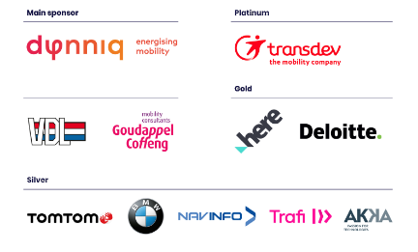
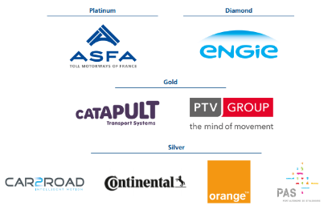
Commercial partners
The ITS Congresses give partners exceptional access to the entire ITS Community, attracting everyone from the most established and recognisable companies, to new players and industry influencers.
Commercial partners 2019
Commercial partners 2017

Slide 5













ITS Associations
We work in close cooperation with ITS Associations from around the World.
In 2019 the ITS European Congress was supported by:
ITS National Associations 2019

Slide 6
Regional Breakdown
Attendees Public / Private background
Our participants are from across Europe.
This regional breakdown includes the world map with top 10 countries highlighted.
85% of participants surveyed found the congress good or excellent.
Countries 2019

Slide 7













Press & Media coverage
Press Conference with high level panel.
55
Journalists attended
Media Partners
20+
Local and international media partners attended

Slide 8



Our digital & social media reach
Impressions
504k
191k
+16,81%
674 likes
+33,55%
2022 Members
Google Display
Facebook
109k
83k
Congress
videos were
watched 1998 times
+8,5%
3881 members
#ITSNL2019 used x 3.52k
Google Search
Quora

Slide 9
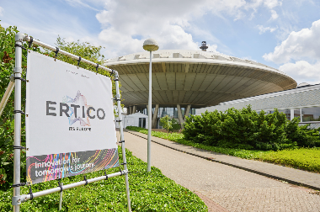
Exhibitions
Exhibitors position themselves among the latest ITS solutions and most advanced technologies that delegates look for. This is the market place for the future of mobility.
160
1500
Exhibitors
Exhibition visitors
550
40
Exhibition personnel
Start-ups

Slide 10
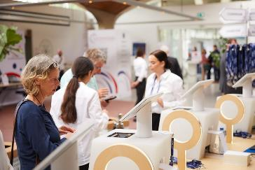
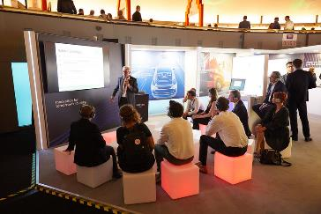
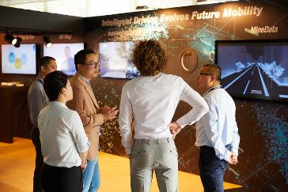
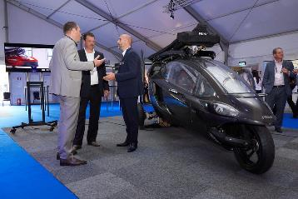
Notes:
Add picturs of stands

Slide 11



Start-up Area
The ITS European Congress dedicates a part of the exhibition to the young ventures of smart mobility. This exclusive space for start-ups gives them the opportunity to present their latest innovations and meet with potential business partners.
100+
Start-up applicants
Start-up Winners 2019:
40
Start-ups on show

Slide 12
Area C: Startup Connector
The congress programme features more than 100 plenary, executive, special interest, technical, scientific and commercial paper sessions. In addition to the packed programme, there are various workshops, associated events and networking opportunities through social functions presenting opportunities for delegates to learn from peers and share knowledge about the latest technologies and policy developments from across the world.
100+
500+
1000+
Sessions
Speakers
Delegates

Slide 13
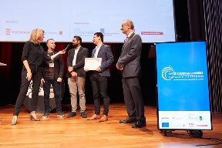
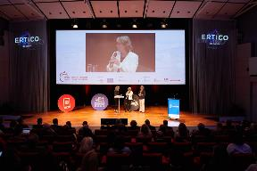
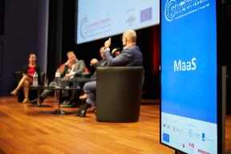
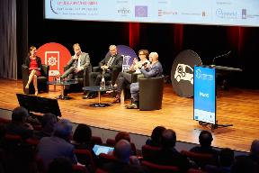
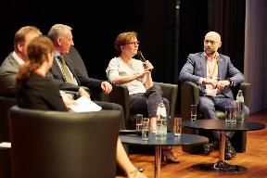
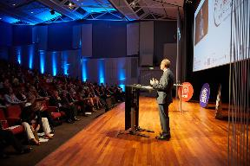
Session Pictures

Slide 14
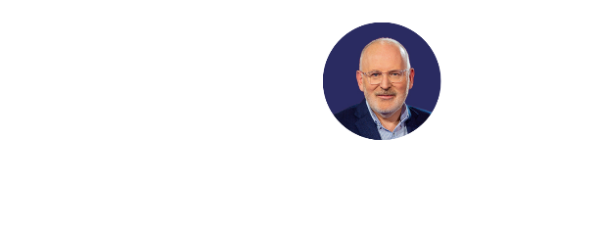

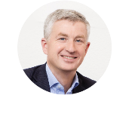
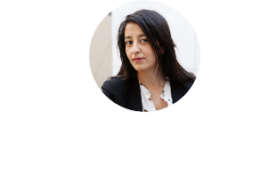
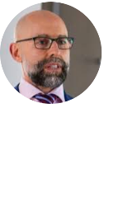
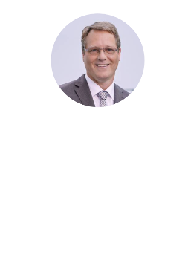
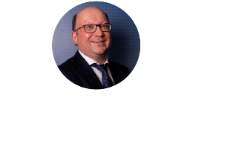
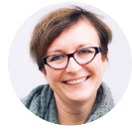
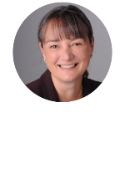
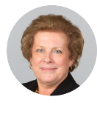
We attracted some outstanding VIP speakers
Cora van Nieuwenhuizen
Minister of Infrastructure and Water Management
Frans Timmermans
European Commissioner and First-Vice President European Commission
Cees de Wijs
CEO
Dynniq
Karima Delli
MEP & Chair woman of committee on transport and tourism
European Parliament
Giancarlo Scaramelli
Commercial Director
Transdev
Joost Vantomme
Smart Mobility Director
ACEA
Armin Gräter
Leader Division Strategy
Autonomous Driving
BMW Group
Leen Balcaen
Sr. Director Industry Solutions
HERE Technologies
Sarah-Jayne Williams
Director Smart Mobility
Ford Europe
Catherine Trautmann
Economic Development
Vice-President for the Eurometropolis of Strasbourg
President of Strasbourg Autonomous Port

Slide 15
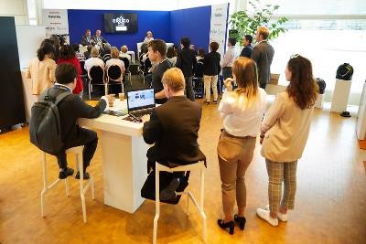
The future of Smart Mobility Solutions
A range of Implementation visits are presented with the implementation programme spread across the host region. This is complimented by an innovative range of demonstrations of the latest state-of-the-art products and solutions for real world mobility scenarios.
15
Implementation Visits
Cities
20
Demonstrations
Notes:
Change image → demo

Slide 16
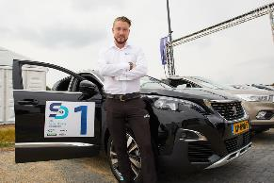
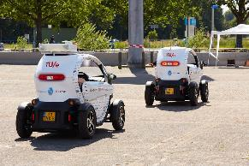
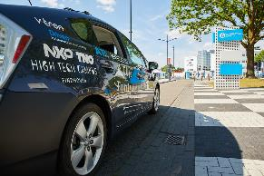
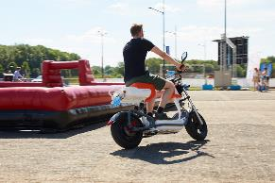
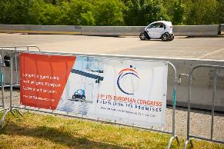
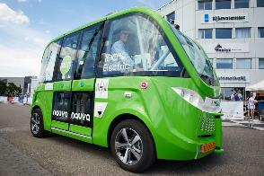

Slide 17
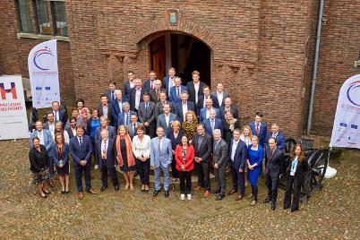
The ITS Summit
The ITS Summit gathers city mayors, national and local politicians, and senior academic and industry leaders from across Europe to explore the current challenges and opportunities in the field of smart mobility and smart cities.
70
35
City representatives
Cities

Slide 18
A few words from our sponsors
“For Dynniq it was great to be the main sponsor at the 13th ITS European Congress in Brainport Eindhoven. We demonstrated our knowledge and expertise of integrated smart mobility solutions to the audience and met a lot of interesting people.”
Mr. Cees de Wijs
CEO Dynniq
“We gained valuable insights and made new connections, thanks to the collaboration with ERTICO-ITS Europe. Goudappel Coffeng was happy to contribute to the great congress vibe”
Mr. Jos van Kleef
CEO Goudappel Coffeng
“For Transdev Netherlands, The ITS Congress turned out to be an excellent opportunity to both share our knowledge on smart mobility and gain new insigths on new products and solutions
Jonne van Eck
Corporate Communications Manager
Notes:
Transdev logo +

Slide 19

Find out how to be part of the next
ITS Congress in Europe!
www.itsineurope.com

